Slide 1
CRISIS INTERVENTION TEAM BASIC TRAINING MATRIX
 | Monday | Tuesday | Wednesday | Thursday | Friday
0750 - 0800 | Roll Call | Roll Call | Roll Call | Roll Call | Roll Call
0800 - 0850 | Introduction, History & Overview | Risk Assessment & Crisis Intervention Skills | Child & Adolescent Disorders | Community Resource Panel/ Mental Health Court Project | Crisis Intervention Role Play & Virtual Hallucinations Machine
0900 – 0950 | Mental Illness: Signs & Symptoms
1000 – 1050 |  |  | Geriatric Issues
1100 – 1150 |  |  | Department Procedures
1200 – 1300 | Lunch | Lunch | Lunch | Crisis Intervention Role Play & Hearing Voices Simulation Exercise | Luncheon
1300 – 1350 | Developmental Disabilities | Family Perspectives & Consumer Panel | Psychotropic Medications |  | Summary & Evaluation
1400 – 1450 | Substance Abuse & Co-Occurring Disorders |  | Legal Issues |  | Written Examination
1500 - 1550 |  |  |  |  | Superintendent’s Ceremony

Slide 3
CRISIS INTERVENTION TEAM Juvenile Advanced CIT
 | Monday | Tuesday | Wednesday | Thursday | Friday
 | Roll Call | Roll Call | Roll Call | Roll Call | Roll Call
0800 – 0850 | Introduction, Child / Adolescent Overview | Substance Abuse & Co-Occurring Disorders | Violence & Urban Trauma Part 1 | Seamless Integration with Schools | Community Resource Panel Luncheon
0900 – 0950 | Child & Adolescent Brain Development | Risk Assessment & Crisis Intervention Skills (The role of law enforcement / first responders & officer safety) | Violence & Urban Trauma Part 2 | Juvenile Legal Issues
1000 – 1050 | Mental Illness: Signs & Symptoms |  | Eating Disorders & Self Injurious Behavior
1100 – 1150 |  |  | Special Circumstances | Mental Health JISC Project
1200 – 1300 | Lunch | Lunch | Lunch | Lunch
1300 – 1350 | Depression & Suicide | Psychotropic Medications | Department Procedures | FBI School Violence & School Shooters | Summary & Evaluation
1400 – 1450 | Medical / Developmental Disabilities | Parents & Teachers As Allies (NAMI) | Family Perspectives & Consumer Panel |  | Written Examination
1500 – 1550 | Autism |  |  |  | Superintendent’s Ceremony

Slide 4
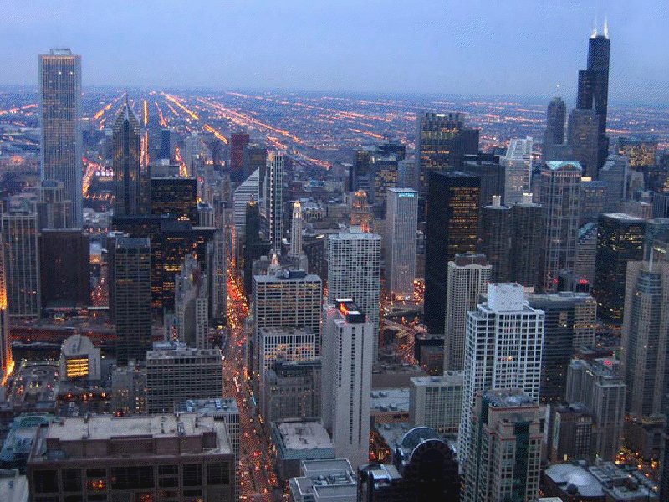
CRISIS INTERVENTION TEAM

